Slide 1
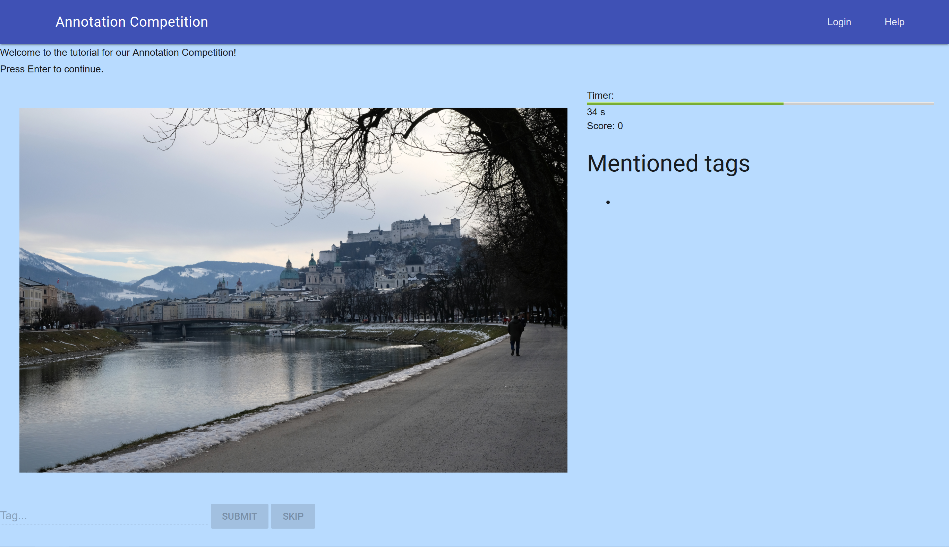

Slide 2
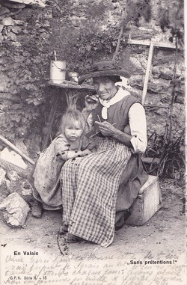
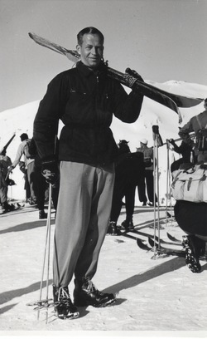
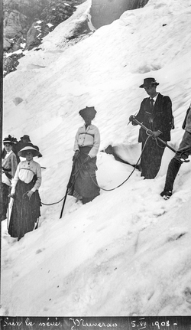
Motivation
Notes:
Lots of unannotated data

Slide 3
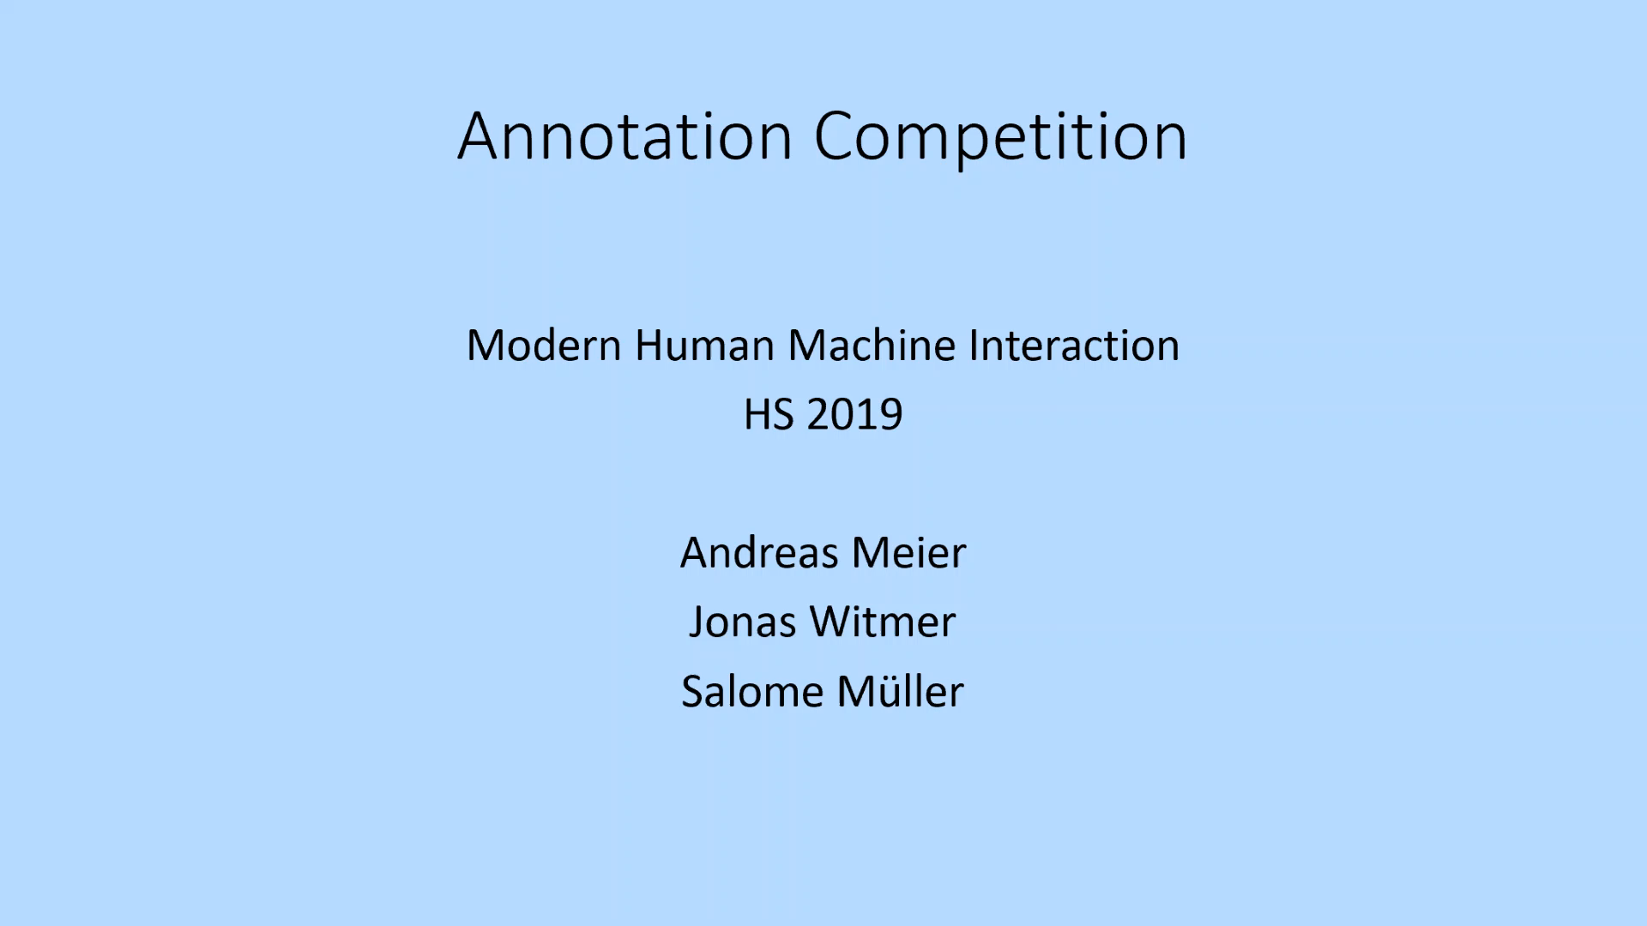

Slide 4
Project Idea
Annotate Images
Classic
Check Quality
Captcha
Asynchronous
Bild von DB Query Tabelle?

Slide 5
Features
Entry Quiz
Tutorial
Help
Documentation
User Authentication
Generalization, rate limitation
Download data

Slide 6

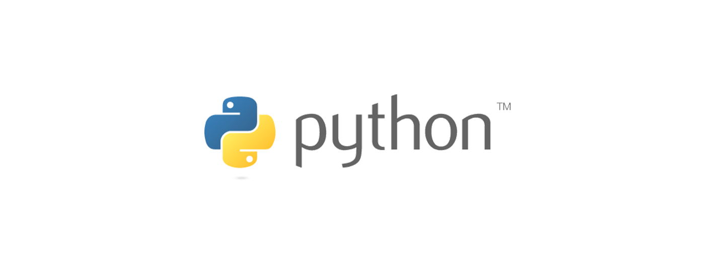
Technologies
Python
ECMAScript
SQL
Flask
GoogleMDL
Spellchecker
Googletrans
NLTK

Slide 7
Architecture
Database
Game Logic
Frontend
User
API
API calls
Image
Tag
Game state
Scoring function
Semantics
Web interface
Tutorial

Slide 8
Semantics
Translation
Synonyms
Spellchecking
Lemmatisation

Slide 9

Future Tasks
Field studies
Performance enhancement
Design
Penalties for spamming
Remove bad tags
Unit tests
Semantic distance

Slide 10

Lessons Learned
More brainstorming in the beginning
Cross browser testing
Field studies need time

Slide 11

Conclusion
A lot more could be done
Positive feedback

